Slide 1
Petri Nets I
Friday, October 21, 2005

Slide 2
Definition of Petri Net
C = ( P, T, I, O)
  Places
  P = { p₁, p₂, p₃, …, p_{n}}
  Transitions
  T = { t₁, t₂, t₃, …, t_{n}}
  Input
  I : T → P^{r} (r = number of places)
  Output
  O : T → P^{q} (q = number of places)
marking µ : assignment of tokens to the places of Petri net µ = µ₁, µ₂, µ₃, … µ_{n}

Slide 3
Applications of Petri Net
Petri net is primarily used for studying the dynamic concurrent behavior of network-based systems where there is a discrete flow.
Petri Nets are applied in practice by industry, academia, and other places. -reference

Slide 4
Basics of Petri Nets
Petri net consist two types of nodes: places and transitions. And arc exists only from a place to a transition or from a transition to a place.
A place may have zero or more tokens.
Graphically, places, transitions, arcs, and tokens are represented respectively by: circles, bars, arrows, and dots.
p₁
t₁
p₂

Slide 5
Basics of Petri Nets -continued
Below is an example Petri net with two places and one transaction.
Transition node is ready to fire if and only if there is at least one token at each of its input places
state transition of form (1, 0) → (0, 1)
p₁ : input place p₂: output place
p₁
t₁
p₂

Slide 6
Properties of Petri Nets
Sequential Execution
Transition t₂ can fire only after the firing of t₁. This impose the precedence of constraints "t₂ after t₁."
Synchronization
Transition t₁ will be enabled only when a token there are at least one token at each of its input places.
Merging
Happens when tokens from several places arrive for service at the same transition.
p₁
t₁
p₂
t₂
p₃
t₁

Slide 7
Properties of Petri Nets
Concurrency
t₁ and t₂ are concurrent.
- with this property, Petri net is able to model systems of distributed control with multiple processes executing concurrently in time.
-continued
t₁
t₂

Slide 8
Properties of Petri Nets
Conflict
t₁ and t₂ are both ready to fire but the firing of any leads to the disabling of the other transitions.
-continued
t₁
t₂
t₁
t₂

Slide 9
Properties of Petri Nets
Conflict - continued
  the resulting conflict may be resolved in a purely non-deterministic way or in a probabilistic way, by assigning appropriate probabilities to the conflicting transitions.
there is a choice of either t₁ and t₂, or t₃ and t₄
-continued
t₁
t₂
t₃
t₄

Slide 10
Example: In a Restaurant (A Petri Net)
Waiter
free
Customer 1
Customer 2
Take
order
Take
order
wait
Order
taken
wait
eating
eating
Tell
kitchen
Serve food
Serve food

Slide 11
Example: In a Restaurant
(Two Scenarios)
Scenario 1:
  Waiter takes order from customer 1; serves customer 1; takes order from customer 2; serves customer 2.
Scenario 2:
  Waiter takes order from customer 1; takes order from customer 2; serves customer 2; serves customer 1.

Slide 12
Example: In a Restaurant (Scenario 1)
Waiter
free
Customer 1
Customer 2
Take
order
Take
order
wait
Order
taken
wait
eating
eating
Tell
kitchen
Serve food
Serve food

Slide 13
Example: In a Restaurant (Scenario 2)
Waiter
free
Customer 1
Customer 2
Take
order
Take
order
wait
Order
taken
wait
eating
eating
Tell
kitchen
Serve food
Serve food

Slide 14
Example: Vending Machine (A Petri net)
Take 15c bar
Deposit 10c
15c
5c
Deposit 5c
Deposit
5c
Deposit
5c
0c
Deposit
5c
Deposit 10c
10c
20c
Deposit 10c
Take 20c bar

Slide 15
Example: Vending Machine (3 Scenarios)
Scenario 1:
  Deposit 5c, deposit 5c, deposit 5c, deposit 5c, take 20c snack bar.
Scenario 2:
  Deposit 10c, deposit 5c, take 15c snack bar.
Scenario 3:
  Deposit 5c, deposit 10c, deposit 5c, take 20c snack bar.

Slide 16
Example: Vending Machine (Token Games)
Take 15c bar
Deposit 10c
15c
5c
Deposit 5c
Deposit
5c
Deposit
5c
0c
Deposit
5c
Deposit 10c
10c
20c
Deposit 10c
Take 20c bar

Slide 17
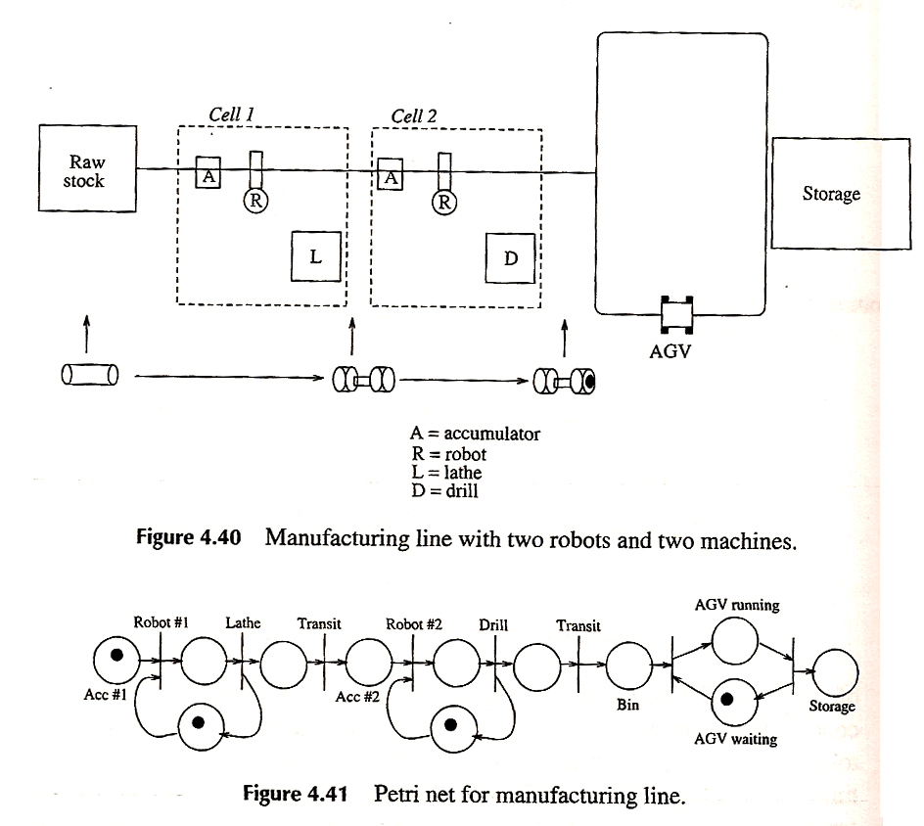
Petri Net examples

Slide 18
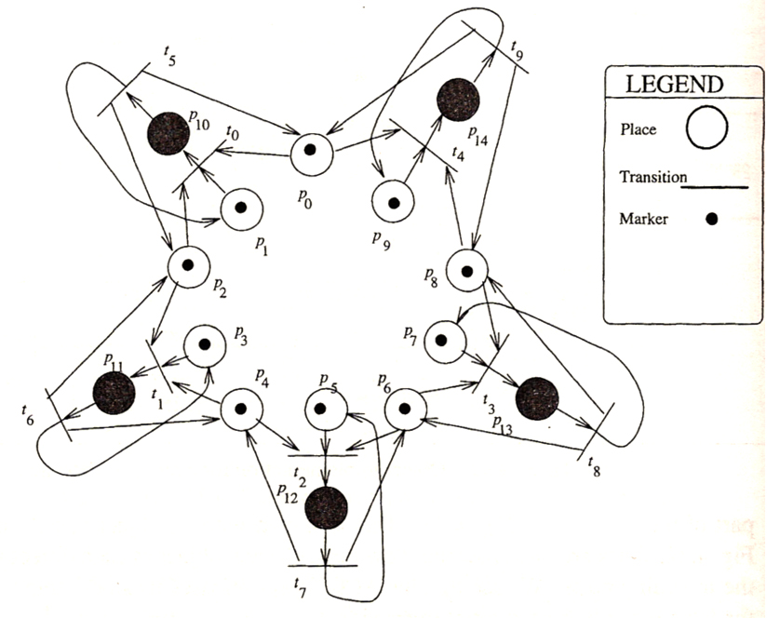
Petri Net examples
(Dining Philosophers)
Five philosophers alternatively think and eating
Chopsticks:
p₀, p₂, p₄, p₆, p₈
Philosophers eating:
p₁₀, p₁₁, p₁₂, p₁₃, p₁₄
Philosophers thinking/meditating:
p₁, p₃, p₅, p₇, p₉

Slide 19
Petri Net with Time
1962 - Carl Adam Petri originally proposed Petri without any notion of time. Concept of time was intentionally avoided because addition of time restricts the behavior of the net.
1970s ~ - Addition of time has been discussed in order to analyze the performance of the modeled system.
Many properties are still undecided for Petri nets extended with data and time.

Slide 20
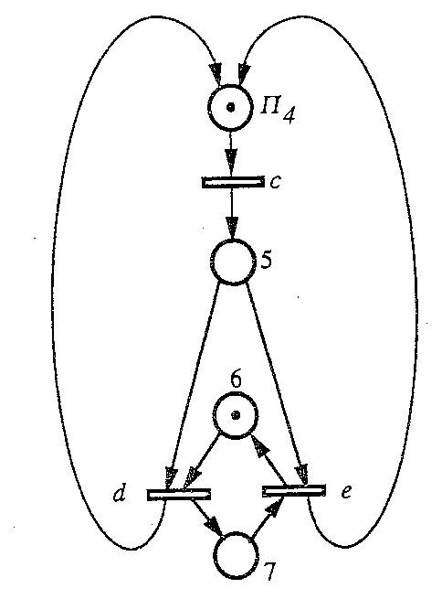
How it works?

Slide 21
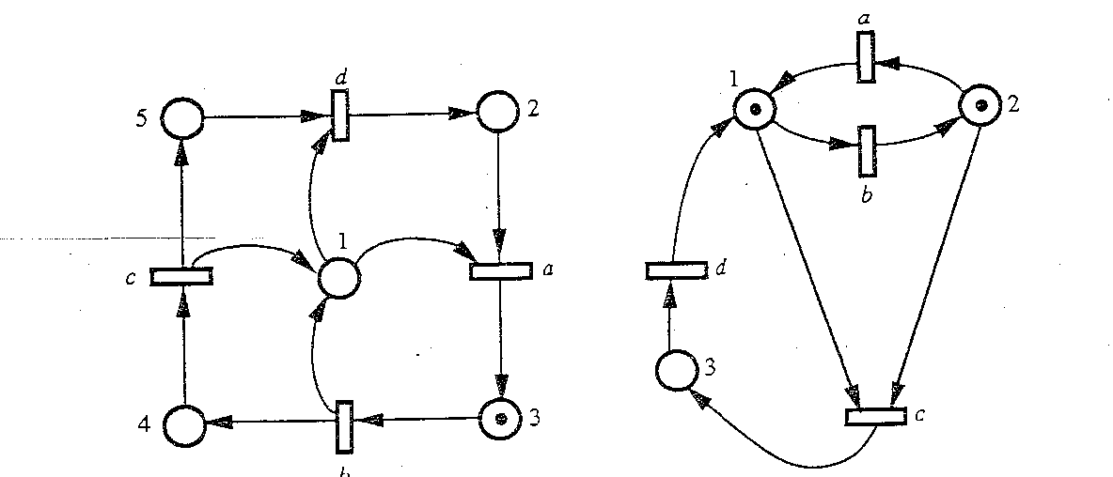
How it works?

Slide 22
References
Fishwick, Paul(1995) – Simulation Model Design and Execution
Petri Nets World
Ling,Chris(2001) – Lecture on Petri Nets Method
Chapman, Nick(1997) – Surprise97 journal on Petri Nets Models

